Slide 1
Nivel de Red
Circuitos Virtuales
Datagramas
IP
Notas de Clase tomadas del Curso de Peterson &Davie

Slide 2
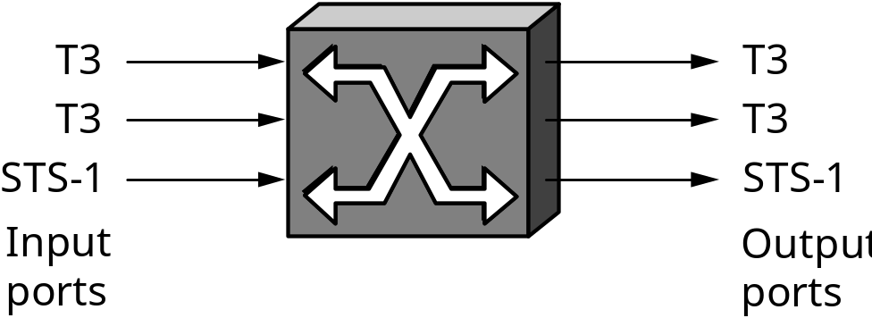
Scalable Networks
Switch
  forwards packets from input port to output port
  port selected based on address in packet header
Advantages
  cover large geographic area (tolerate latency)
  support large numbers of hosts (scalable bandwidth)

Slide 3
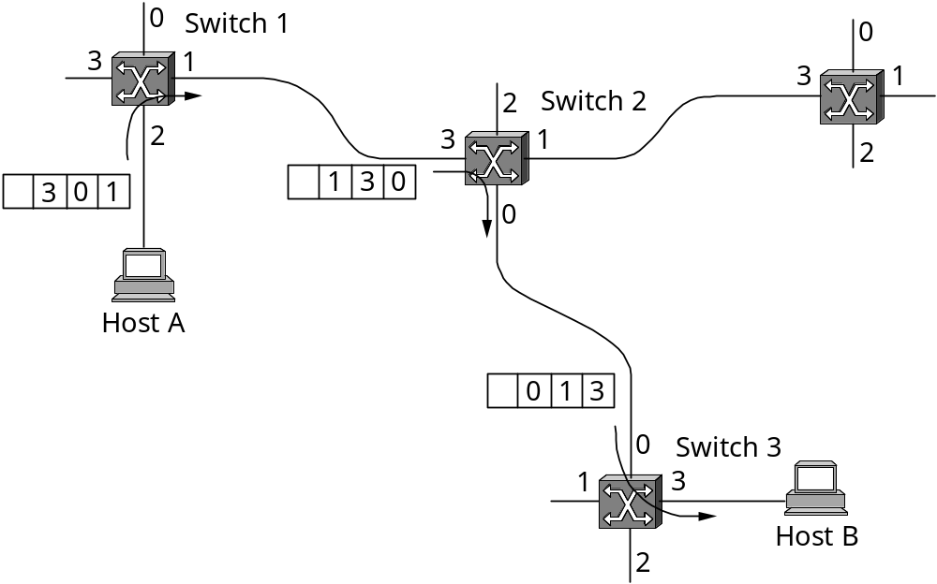
Source Routing

Slide 4
Virtual Circuit Switching
Explicit connection setup (and tear-down) phase
Subsequence packets follow same circuit
Sometimes called connection-oriented model
0
0
0
3
1
3
1
11
3
1
Analogy: phone call
Each switch maintains a VC table
Switch 1
Switch 2
2
2
2
5
7
0
Switch 3
3
1
Host A
4
Host B
2

Slide 5
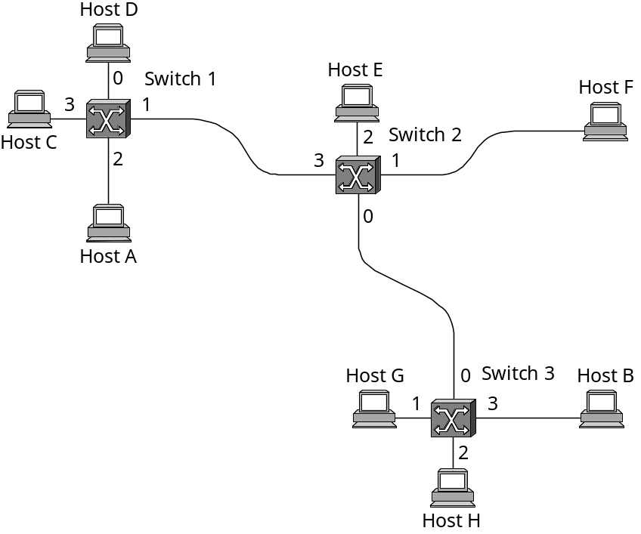
Datagram Switching
No connection setup phase
Each packet forwarded independently
Sometimes called connectionless model
Analogy: postal system
Each switch maintains a forwarding (routing) table

Slide 6
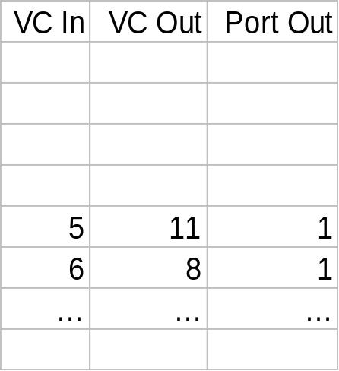
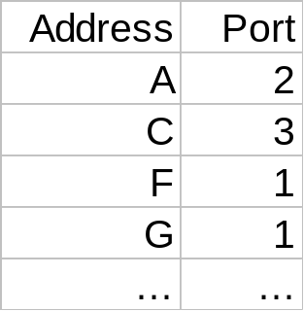
Example Tables
Circuit Table
(switch 1, port 2)
Forwarding Table
(switch 1)

Slide 7
Virtual Circuit Model
Typically wait full RTT for connection setup before sending first data packet.
While the connection request contains the full address for destination, each data packet contains only a small identifier, making the per-packet header overhead small.
If a switch or a link in a connection fails, the connection is broken and a new one needs to be established.
Connection setup provides an opportunity to reserve resources.

Slide 8
Datagram Model
There is no round trip delay waiting for connection setup; a host can send data as soon as it is ready.
Source host has no way of knowing if the network is capable of delivering a packet or if the destination host is even up.
Since packets are treated independently, it is possible to route around link and node failures.
Since every packet must carry the full address of the destination, the overhead per packet is higher than for the connection-oriented model.

Slide 9
Internetworking
Outline
  Best Effort Service Model
  Global Addressing Scheme

Slide 10
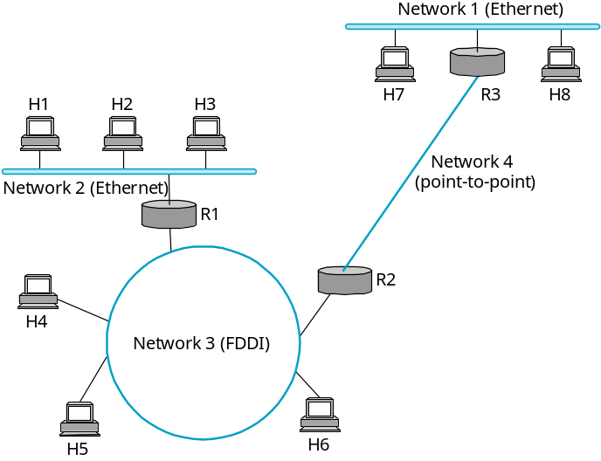
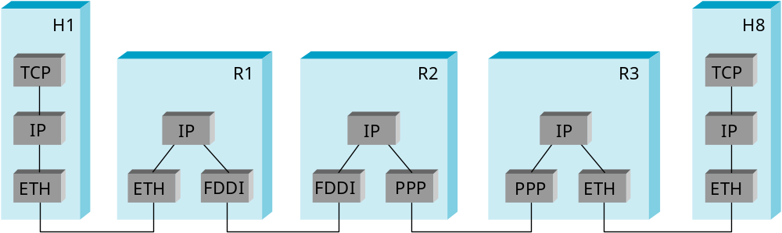
IP Internet
Concatenation of Networks
Protocol Stack

Slide 11
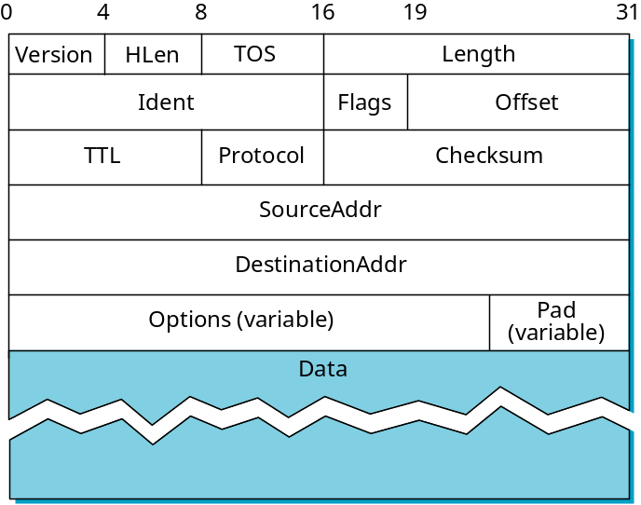
Service Model
Connectionless (datagram-based)
Best-effort delivery (unreliable service)
  packets are lost
  packets are delivered out of order
  duplicate copies of a packet are delivered
  packets can be delayed for a long time
Datagram format

Slide 12
Fragmentation and Reassembly
Each network has some MTU
Design decisions
  fragment when necessary (MTU < Datagram)
  try to avoid fragmentation at source host
  re-fragmentation is possible
  fragments are self-contained datagrams
  use CS-PDU (not cells) for ATM
  delay reassembly until destination host
  do not recover from lost fragments

Slide 13
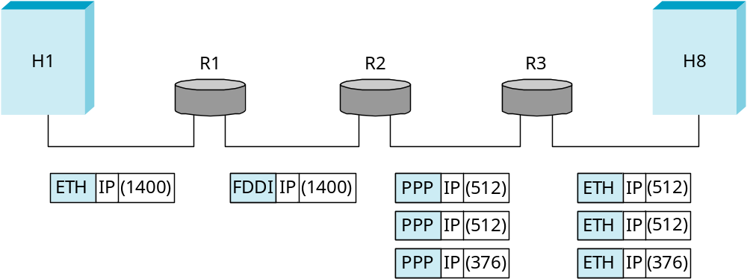
Example
Start of header
Ident = x
0
Offset = 0
Rest of header
(a)
1400 data bytes
Start of header
Ident = x
1
Offset = 0
Rest of header
512 data bytes
(b)
Start of header
Ident = x
1
Offset = 64
Rest of header
512 data bytes
Start of header
Ident = x
0
Offset = 128
Rest of header
376 data bytes

Slide 14
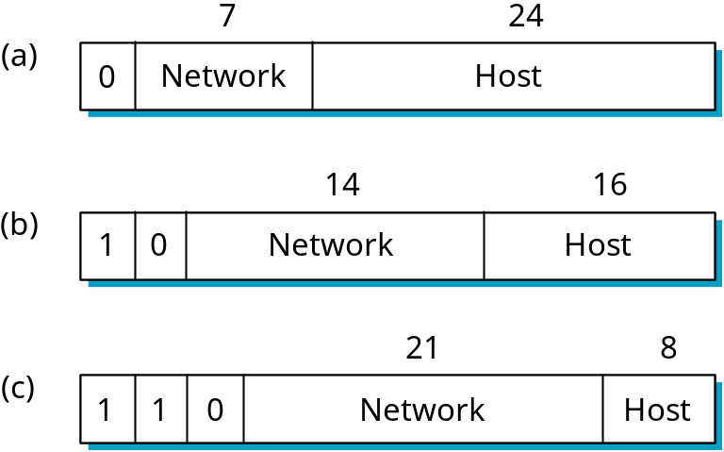
Global Addresses
Properties
  globally unique
  hierarchical: network + host
Dot Notation
  10.3.2.4
  128.96.33.81
  192.12.69.77

Slide 15
Datagram Forwarding
Strategy
  every datagram contains destination’s address
  if connected to destination network, then forward to host
  if not directly connected, then forward to some router
  forwarding table maps network number into next hop
  each host has a default router
  each router maintains a forwarding table
Example (R2) Network Number Next Hop
1 R3
2 R1
3 interface 1
4 interface 0

Slide 16
Address Translation
Map IP addresses into physical addresses
  destination host
  next hop router
Techniques
  encode physical address in host part of IP address
  table-based
ARP
  table of IP to physical address bindings
  broadcast request if IP address not in table
  target machine responds with its physical address
  table entries are discarded if not refreshed

Slide 17
ARP Details
Request Format
  HardwareType: type of physical network (e.g., Ethernet)
  ProtocolType: type of higher layer protocol (e.g., IP)
  HLEN & PLEN: length of physical and protocol addresses
  Operation: request or response
  Source/Target-Physical/Protocol addresses
Notes
  table entries timeout in about 10 minutes
  update table with source when you are the target
  update table if already have an entry
  do not refresh table entries upon reference

Slide 18
ARP Packet Format
0
8
16
31
Hardware type = 1
ProtocolType = 0x0800
HLen = 48
PLen = 32
Operation
SourceHardwareAddr (bytes 0
―
3)
SourceHardwareAddr (bytes 4
―
5)
SourceProtocolAddr (bytes 0
―
1)
SourceProtocolAddr (bytes 2
―
3)
TargetHardwareAddr (bytes 0
―
1)
TargetHardwareAddr (bytes 2
―
5)
TargetProtocolAddr (bytes 0
―
3)

Slide 19
Internet Control Message Protocol (ICMP)
Echo (ping)
Redirect (from router to source host)
Destination unreachable (protocol, port, or host)
TTL exceeded (so datagrams don’t cycle forever)
Checksum failed
Reassembly failed
Cannot fragment

